Slide 1
The Partisan patriot
Sam Marcotte

Slide 2
Introduction
Do voters perceive patriotic statements through a partisan lens?
Notes:
Do voters perceive patriotic statements through a partisan lens? I argue that citizens will be more likely to agree with patriotic sentiments and view the source as more credible when the information comes from an official of the same political party. I find that respondents who receive patriotic statements from an official from the opposite party view the source as less credible; while there is no statistical difference in response to patriotic statements between the treatment and control groups, I find that Democrats agree with patriotic statements at a somewhat smaller but statistically significant rate than Republicans regardless of the source of the information. I also analyze tweets in the United States containing “#patriotism” and find three distinct topics that align with the theoretical types of patriotism.

Slide 3
Framework
Social Identity Theory
Partisanship serves as a perceptual lens that can shape interpretation of events and information, including the credibility of the message and the messenger. (Greene 1999, 2002, 2004; Huddy et al. 2015).
Messaging
The message may not count as much as the messenger (Baum and Groeling 2008).
Patriotism
Little work focuses on patriotic sentiment in general and more on rally-round-the-flag effects (e.g. Sullivan 1992, Huddy 2007).
Two main types: blind and constructive (Schatz, Staub, and Lavine 1999).
Notes:
Partisanship comprises a key component of many people’s identity and can serve as a perceptual lens that can shape the interpretation of events and information, including the credibility of the message and the messenger; I argue that that one’s partisan identity plays a key role in the evaluation of partisan officials and political messages.
Additionally, a given message may not count as much as the identity of the messenger. Because partisanship shapes the way we view the world, voters may perceive political messages in a more negative way when the message comes from an official of the party that conflicts with their party ID, and I argue that voters also evaluate patriotic messages through this partisan lens.
Most political science work focuses on rally-round-the-flag effects and the president’s role in foreign affairs but neglect the importance of regular, every-day patriotic feelings. Political psychology offers most of the patriotism literature, and focuses on two main types of patriotism: blind and constructive. Blind patriotism involves a deep, emotional, and unconditional love of country while constructive patriotism involves more critical evaluation of one’s country and its actions. Some literature suggests that patriotism is mostly a bipartisan feeling in general but none address how the role of a person’s party ID may function when patriotic messages come from partisan officials; I argue that partisanship and the broader political landscape plays an integral role in evaluating patriotic sentiment.

Slide 4
Methods
Experimental survey created in Qualtrics and administered via Amazon’s Mechanical Turk
Respondents are presented with a series of patriotic statements and asked to rate the degree to which they agree with each statement and asked the degree to which they view the source as credible
Control group
Receives these statements from a White House official from an administration that matches their reported party ID
Treatment Group
Receives these statements a White House official from an administration that contradicts their reported party ID
https://ugeorgia.qualtrics.com/jfe/form/SV_3yBMwYZBqCjXnY9
Notes:
To test this, I use an experimental survey present respondents with a series of patriotic statements (two are constructive, two are blind, and two are neutral statements) and they are randomly assigned to two groups: the control group receives these statements from an official of the party matching the respondent’s party ID and the treatment group receives these statements from an official opposite from the respondent’s reported party ID. I ask the respondents the degree to which they agree with each statement on a scale from 1-100 and use the mean as a “patriotism score.” I also ask the degree to which the respondent views the source as credible on a sliding scale from 1-100. The survey was created in Qualtrics and distributed via Amazon’s Mechanical Turk to 122 anonymous respondents. To get a better idea of the survey, let’s take a look: https://ugeorgia.qualtrics.com/jfe/form/SV_3yBMwYZBqCjXnY9

Slide 5
methods
Extract tweets containing “#patriotism” in the United States
Run a topic model to examine what these tweets contain

Slide 6
Hypotheses
H1: Respondents who receive information from an official of the opposite party will agree less with patriotic sentiment than those who receive the information from an official of the matching party.
H2: Respondents who receive information from an official of the opposite party will perceive the source as less credible than those who receive the information from an official of the matching party.
H3: Tweets containing the hashtag "patriotism" will adhere to the two main types of patriotism discussed in political science literature: blind and constructive.
Notes:
I hypothesize the following:
H1: Respondents who receive information from an official of the opposite party will agree less with patriotic sentiment than those who receive the information from an official of the matching party.
H2: Respondents who receive information from an official of the opposite party will perceive the source as less credible than those who receive the information from an official of the matching party.
H3: Tweets containing the hashtag "patriotism" will adhere to the two main types of patriotism discussed in political science literature: blind and constructive.

Slide 7
Findings
Notes:
So what do we find?

Slide 8
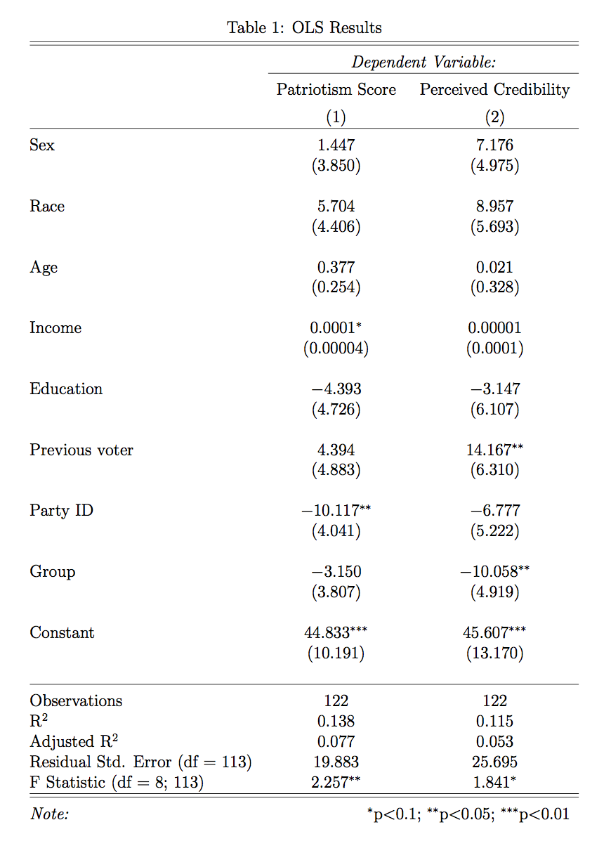
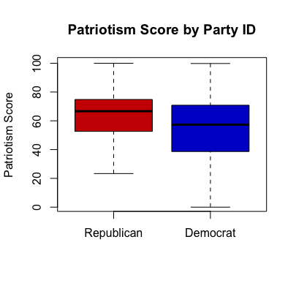
Notes:
I find that respondents who receive patriotic statements from an official of the oppo- site party rate the perceived credibility of the information source an average of 10.058 points lower than those in the control group, ceteris paribus; while there is no statistical difference in response to patriotic statements between the treatment and control groups, I find that Democrats agree with patriotic statements an average of 10.117 lower than Republicans regardless of the source of the information, all else equal. Additionally, I find that those who voted in the previous presidential election rate the perceived credibility of the source 14.167 points, on average and all else equal, higher than those who did not vote. I also find a small but statistically significant positive relationship between income and agreement with patriotic statements.

Slide 9
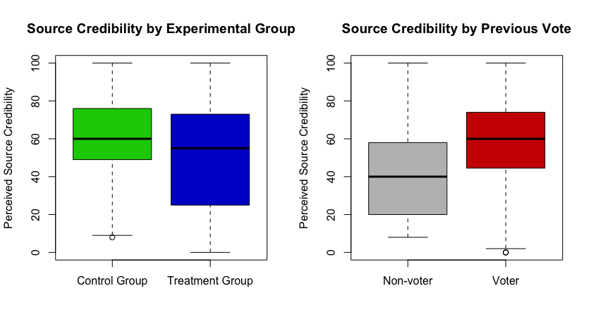
Notes:
I find that respondents who receive patriotic statements from an official of the oppo- site party rate the perceived credibility of the information source an average of 10.058 points lower than those in the control group, ceteris paribus; while there is no statistical difference in response to patriotic statements between the treatment and control groups, I find that Democrats agree with patriotic statements an average of 10.117 lower than Republicans regardless of the source of the information, all else equal. Additionally, I find that those who voted in the previous presidential election rate the perceived credibility of the source 14.167 points, on average and all else equal, higher than those who did not vote. I also find a small but statistically significant positive relationship between income and agreement with patriotic statements.

Slide 10
Findings
Topic 1 | Topic 2 | Topic 3
patriot | patriot | patriot
flag | peopl | jack
amp | need | war
meettheserb | stop | global
mean | confus | union
get | johnsen | place
americafirst | maria | direct
countri | xenophobia | durat
america | racism | hooya
india | htt | navi
Notes:
It appears tweets containing the hashtag patriotism fall pretty clearly into the groups described in the literature about patriotism. Topic 1 seems to be made up of blind patriotism based on words like flag, americafirst, america, etc. Topic 2 seems to be constructive quotes, noting features like xenophobia and racism. Finally, topic 3 seems to involve patriotism as it relates to foreign affairs, given words like war and global.

Slide 11
Analysis
I find no support for H1
But Democrats feel less patriotic than Republicans regardless of the information source
Support for H2.
Partisans view a source as less credible when it comes from a member of the opposite party
Also: rich people feel more patriotic
Tweets contain three reasonably distinct topics that match theoretical expectations.
Notes:
While I do not find support for my main hypothesis (H1), it is not surprising that Democrats feel less warmly towards patriotic sentiment than Republicans given the cur- rent American political landscape. I posit I did not find support for H1 due to phrasing: presenting respondents with fabricated information from the Obama administration does not transport them back in time to a period where a Democrat was in charge of the country. If I were to repeat this survey, I might present the Republican source as a member of the Bush administration so the two are more comparable. It seems likely that members of the out-party may feel less patriotic than the in-party, though more data is needed to substantiate this claim. Alternatively, the proximity to defeat in an election in which Democrats thought their candidate had a sure chance of winning may have left them feeling left patriotic and these findings may not hold in other elections (shoutout to my girl Hillary).
I do find support for H2, which suggests that partisans view information from a conflicting source as less credible. I am not quite certain the mechanism linking previous vote and perceived source credibility– perhaps previous voters were more engaged with the election and willing to accept the credibility of a party source regardless of their party ID? That said, there are very few respondents who did not vote in the previous election. Finally, it is also not surprising that wealthier Americans may feel more patriotic than their poorer counterparts regardless of party ID– I imagine it is much easier to feel sanguine about your country when your bank account is also in good health.
Finally, tweets containing patriotism fall into three reasonably distinct topics that match theoretical expectations.

Slide 12
Conclusion
Notes:
To conclude: These findings demonstrate differences in agreement with patriotic feelings between parties– not between groups receiving patriotic sentiment from conflicting partisan sources. Instead, it seems more likely that partisans whose team is not in the White House feel less in agreement with patriotic statements. this claim. This paper does provide evidence, though, that the public views information from a source of the opposite party as less credible and that tweets discussing patriotism can indeed be separated by theoretical groups.
Questions?

Slide 13
Extra slides

Slide 14
